Slide 1
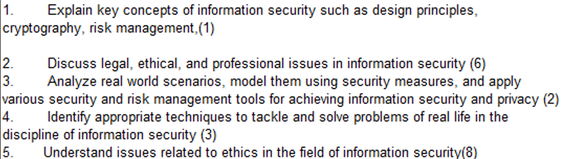
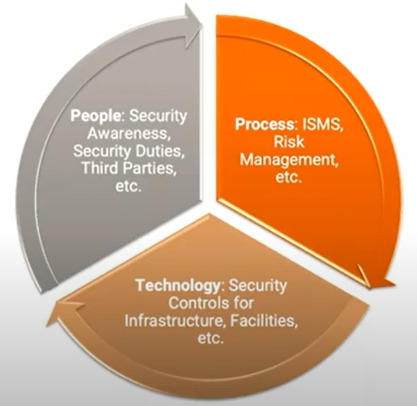
CS 3002 Information Security
Fall 2023
Week # 3 – Lecture # 7, 8, 9
Dr. Aqsa Aslam

Slide 2
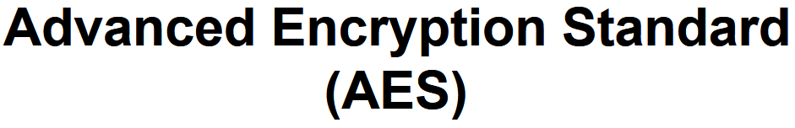

Slide 3
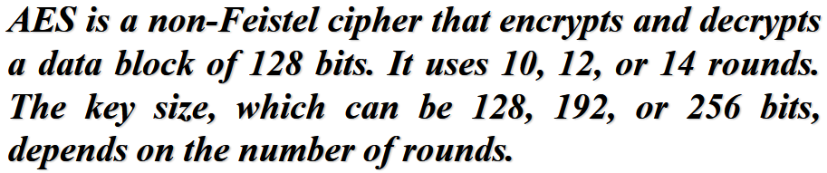
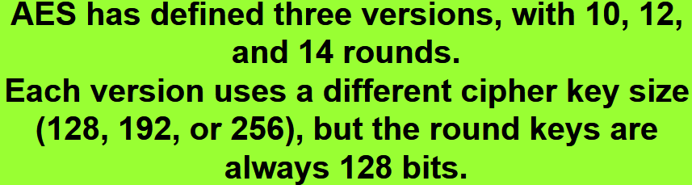

Slide 4
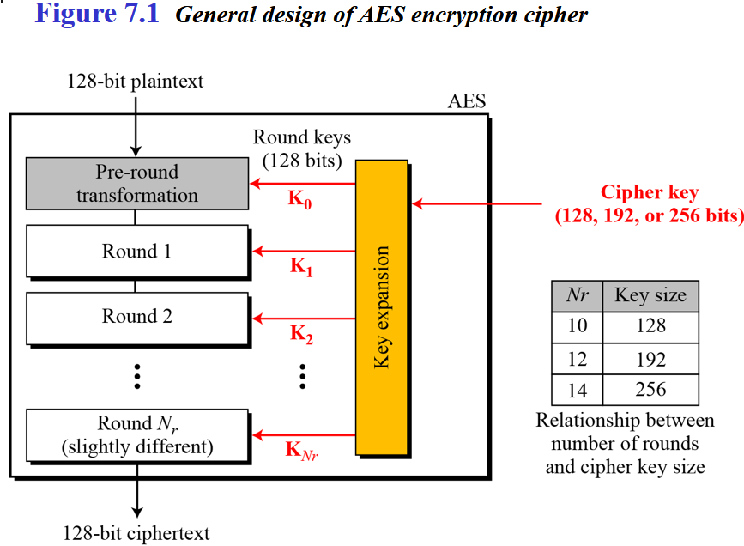
Fixed size=128 bit i-e., 16bytes
→ No: of key generated =no: of round+1(extra for pre-round transformation)

Slide 5
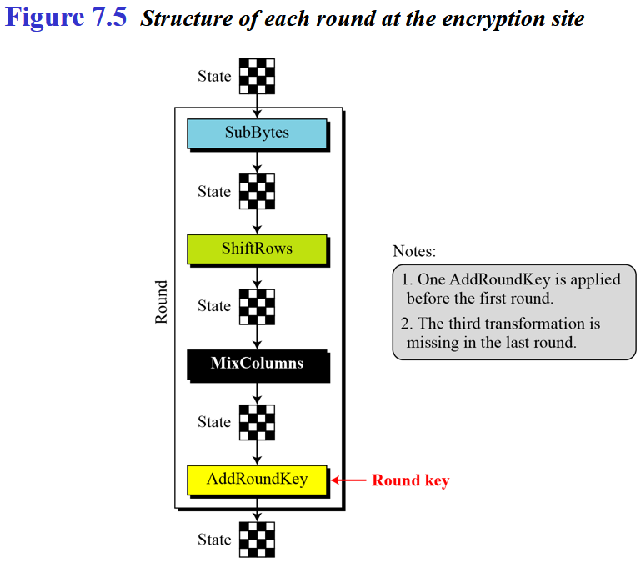

Slide 6
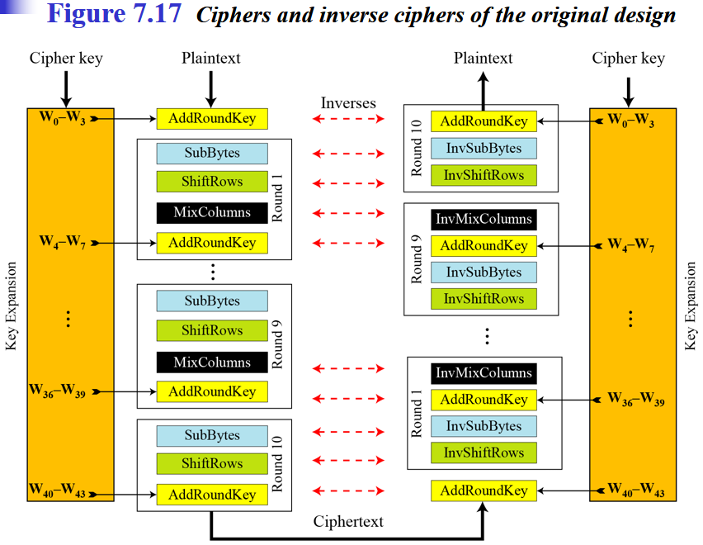

Slide 7
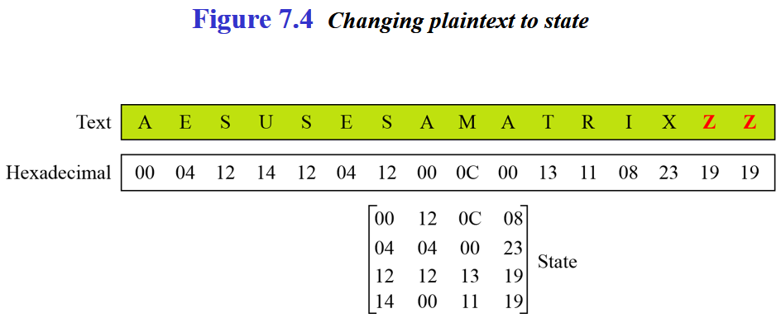
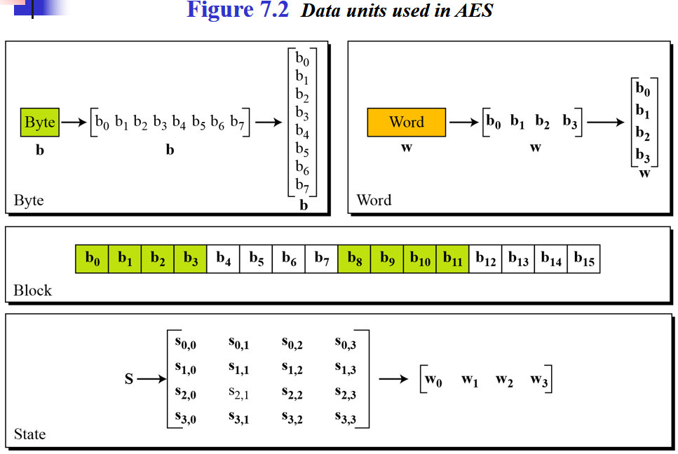
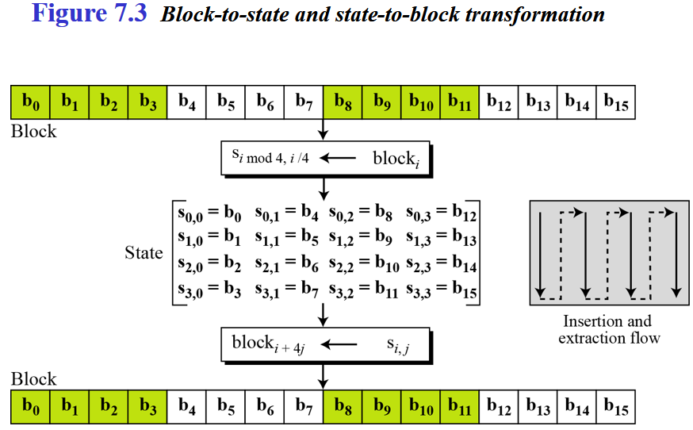

Slide 8
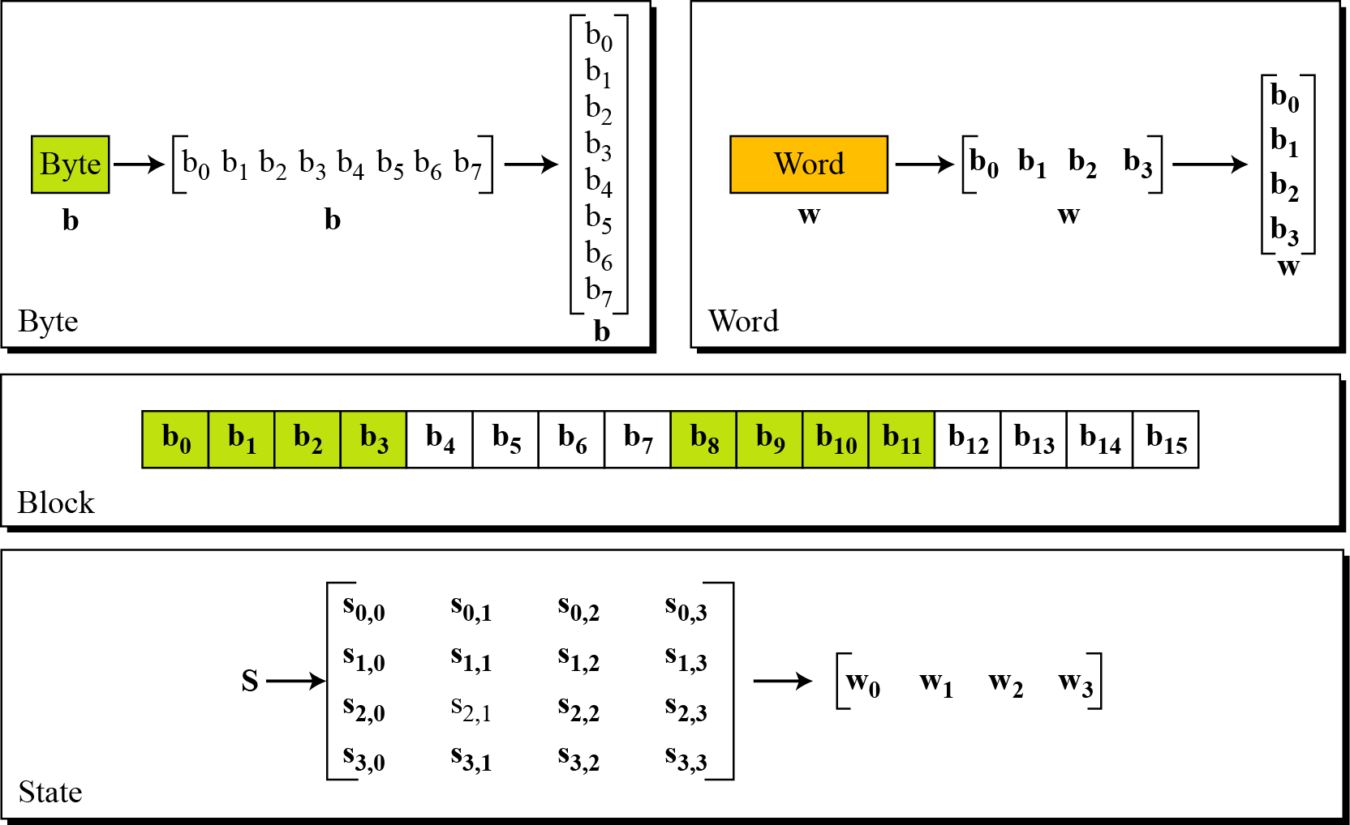
Data Units.
1 byte= group of 8 bit
1 word=4 bytes=32 bit
Block size=128 bit data
Figure 7.2 Data units used in AES
4 word
4×4=16 bytes i-e
128 bits or 4 words
1 byte
S_{0,0 =}1st byte of 0th word
1 word
State: it told intermediate result

Slide 9
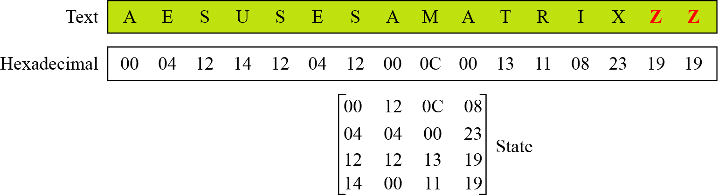
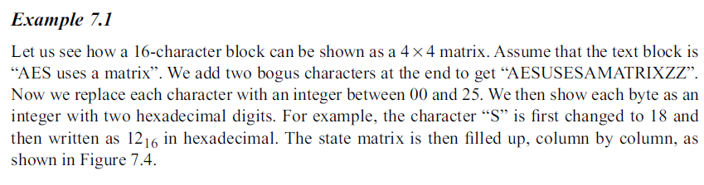
7.1.4 Continue
Example 7.1
Continue
Figure 7.4 Changing plaintext to state

Slide 10
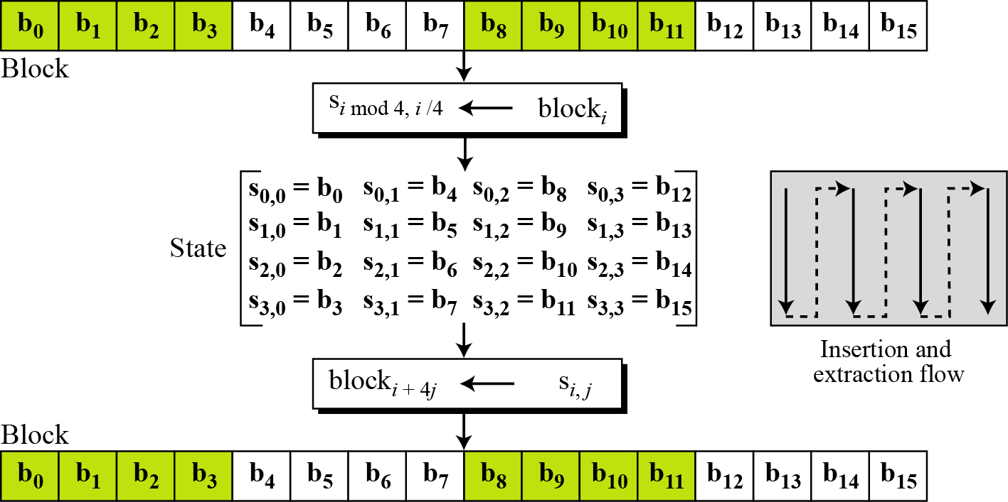
7.1.4 Data Units.
Figure 7.3 Block-to-state and state-to-block transformation

Slide 11
AES - steps
KeyExpansion — round keys are derived from the cipher key using Rijndael's key schedule.
Initial Round
AddRoundKey—each byte of the state is combined with the round key using bitwise xor.
Round
Four different stages are used, one of permutation and three of substitution:
Substitute Bytes: Uses a table, referred to as an S-box,3 to perform a byte-by-byte substitution of the block
Shift Rows: A simple permutation that is performed row by row
Mix Columns: A substitution that alters each byte in a column as a function of all of the bytes in the column
Add Round key: A simple bitwise XOR of the current block with a portion of the expanded key
Final Round (no Mix-Columns)
SubBytes
ShiftRows
AddRoundKey
TRANSFORMATIONS
Four different stages are used, one of permutation and three of substitution:
Substitute Bytes: Uses a table, referred to as an S-box,3 to perform a byteby-byte substitution of the block
Shift Rows: A simple permutation that is performed row by row
Mix Columns: A substitution that alters each byte in a column as a function of all of the bytes in the column
Add Round key: A simple bitwise XOR of the current block with a portion of the expanded key

Slide 12

7.2.1 Substitution
AES, like DES, uses substitution. AES uses two invertible transformations.
SubBytes
The first transformation, SubBytes, is used at the encryption site. To substitute a byte, we interpret the byte as two hexadecimal digits.
Note
The SubBytes operation involves 16 independent byte-to-byte transformations.

Slide 13
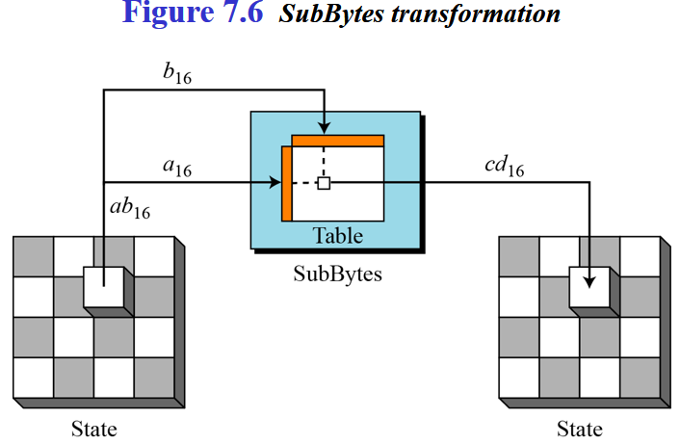
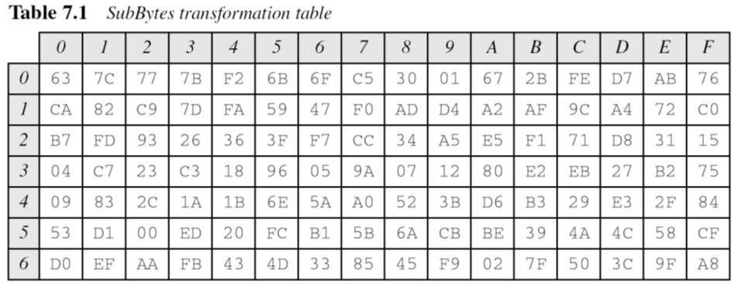
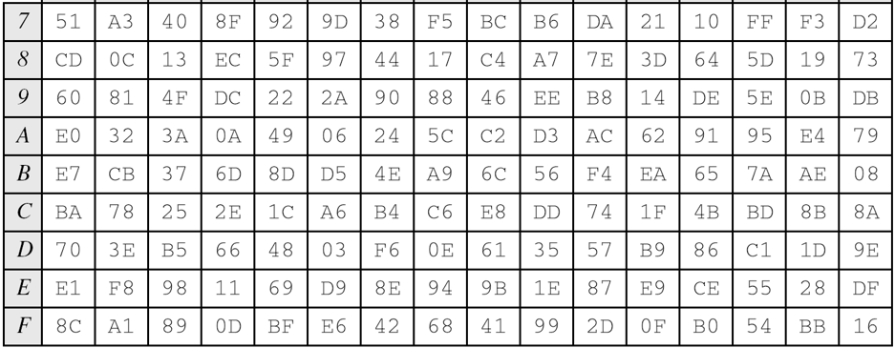
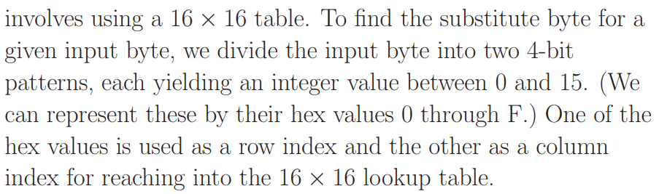
16×16= S-box
SubBytes is simply a table lookup using a 16×16 matrix of byte values called an s-box.
This matrix consists of all the possible combinations of an 8 bit sequence (28= 16×16 = 256).

Slide 14

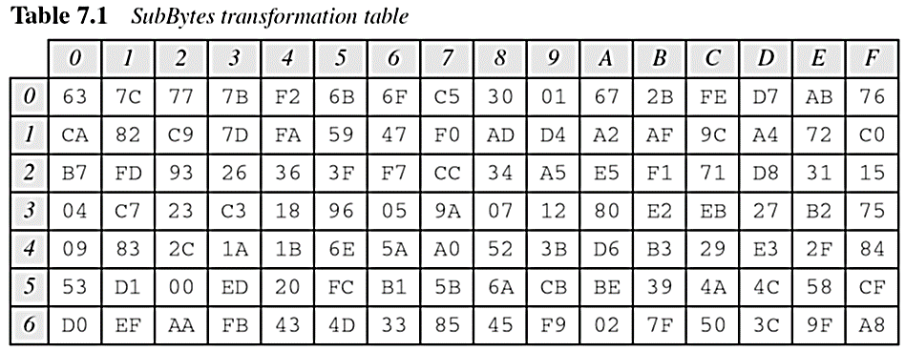
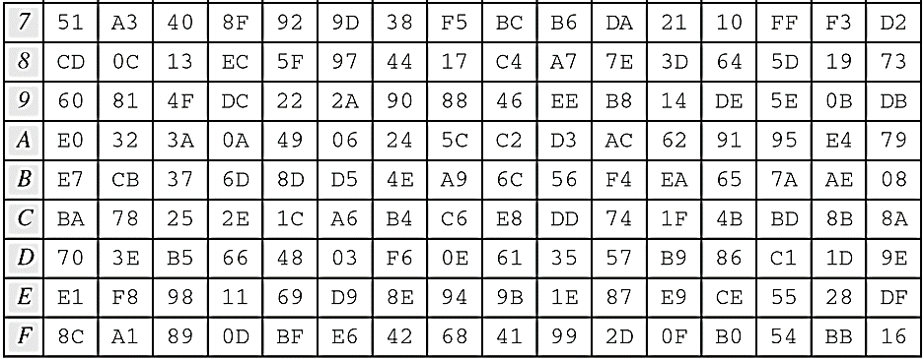
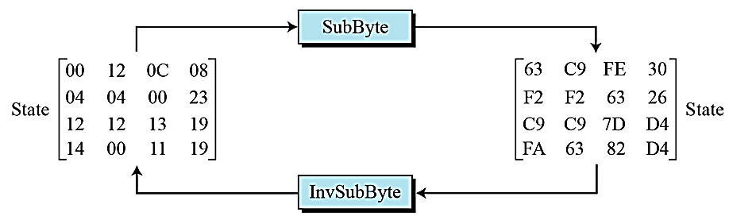
16×16= S-box

Slide 15
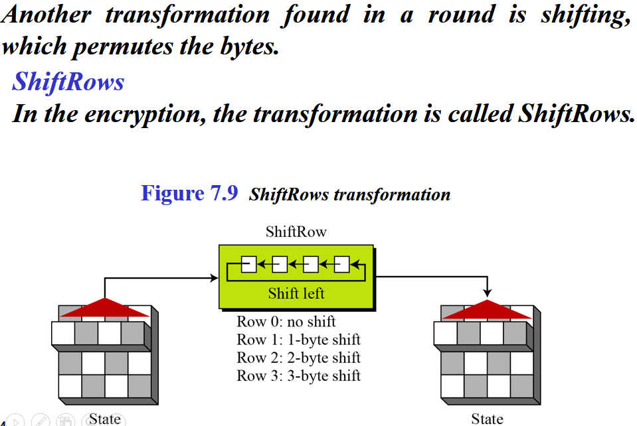
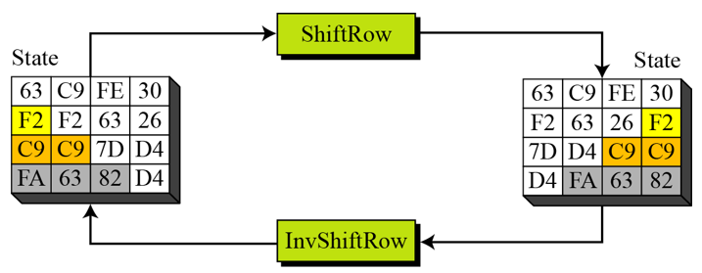
Permutation perform on a byte level
Shift is done to the left
Shift depends on the nrow of the matrix

Slide 16
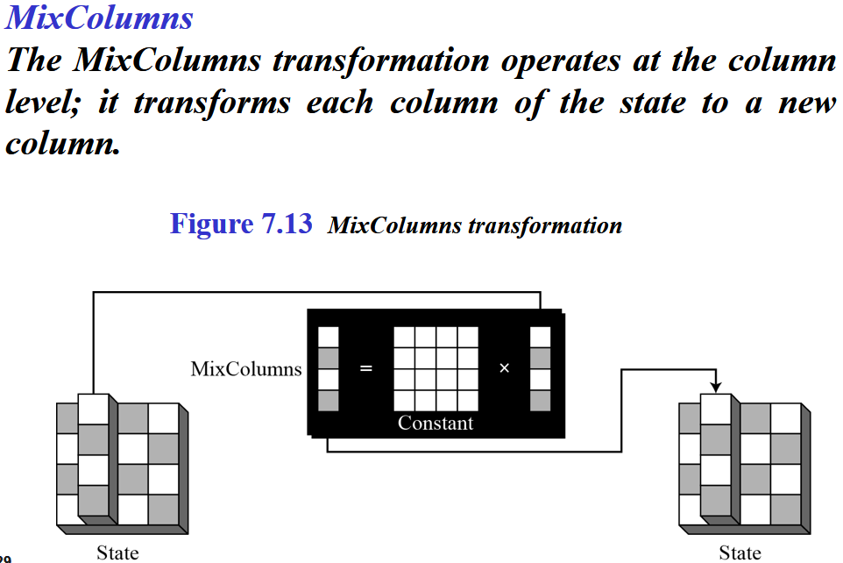
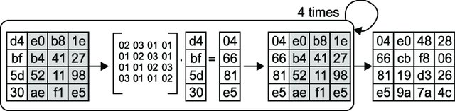

Slide 17

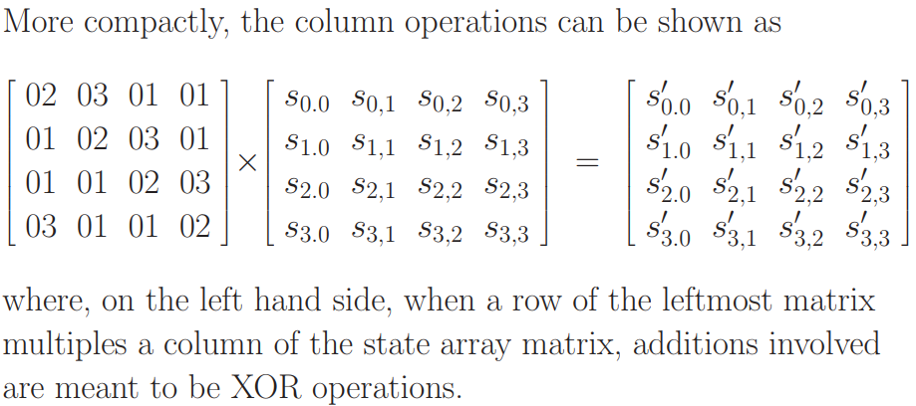
* The multiplications implied by the word ‘times’ and the additions implied by the word ‘plus’ are meant to be carried out in GF(2⁸) arithmetic

Slide 18
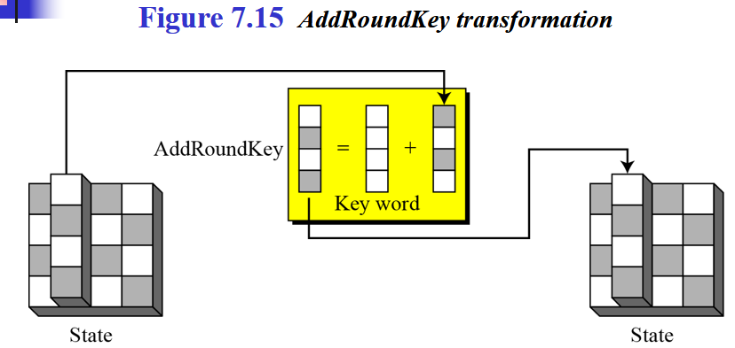
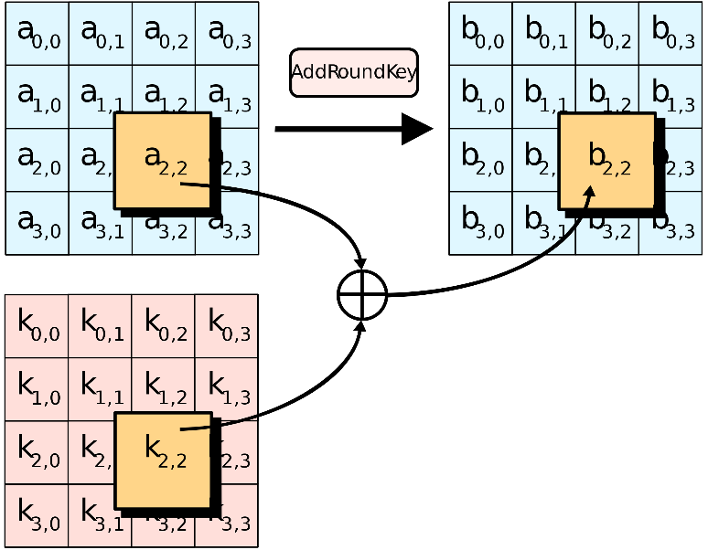
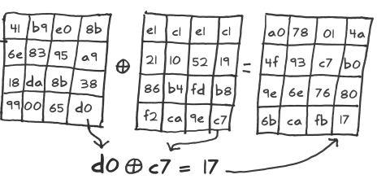
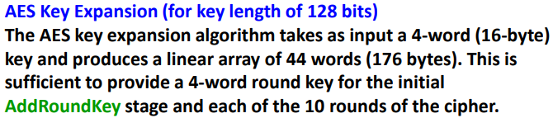

Slide 19
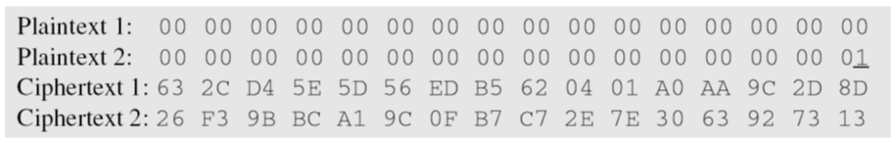
Claude Shannon (1949) gave two properties that a good cryptosystem should have to hinder statistical analysis: diffusion and confusion.
Diffusion means that if we change a character of the plaintext, then several characters of the ciphertext should change, and similarly, if we change a character of the ciphertext, then several characters of the plaintext should change.
Confusion means that the key does not relate in a simple way to the ciphertext. In particular, each character of the ciphertext should depend on several parts of the key.
Confusion = Substitution a --> b, Diffusion = Transposition or Permutation abcd --> dacb

Slide 20
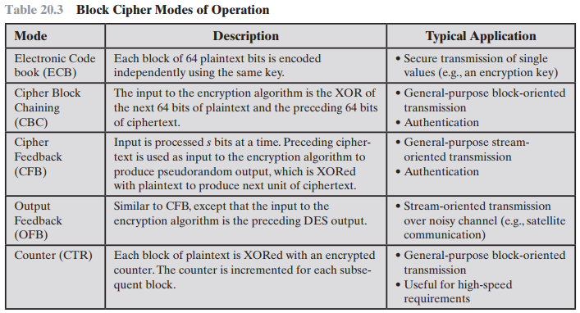

Slide 21
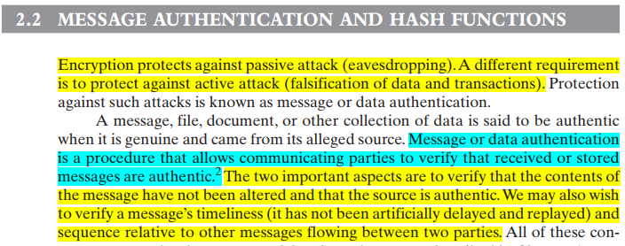

Slide 22
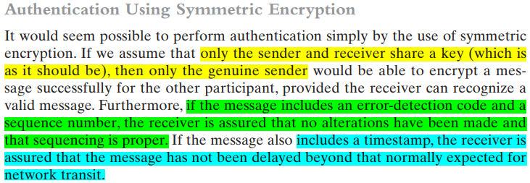

Slide 23
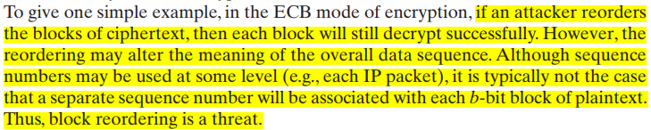
Message encryption by itself does not provide a secure form of authentication.
It is possible to combine authentication and confidentiality in a single algorithm by encrypting a message plus its authentication tag.
Message authentication is provided as a separate function from message encryption.

Slide 24
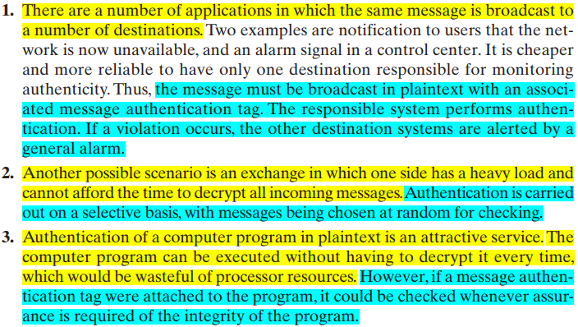
Three situations in which message authentication without confidentiality is preferable:

Slide 25
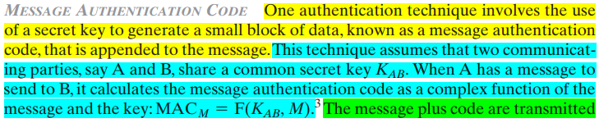


Slide 26
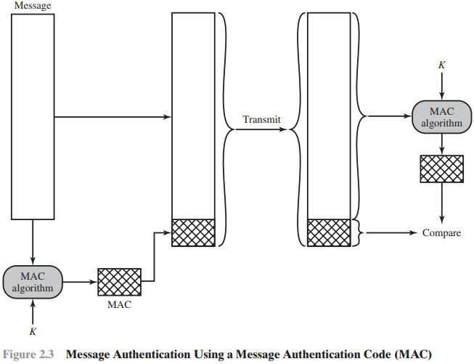
DES or AES is used to generate an encrypted version of the message, and some of the bits of ciphertext are used as the code. Longer codes are used to provide sufficient collision resistance. One difference is that the authentication algorithm need not be reversible, as it must for decryption.

Slide 27
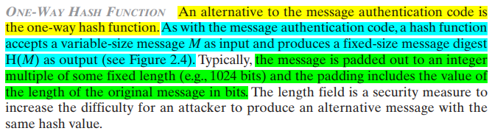


Slide 28
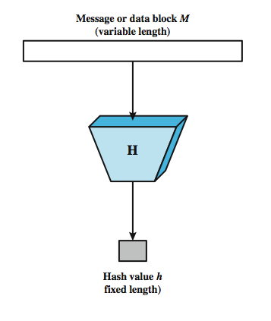

Slide 29
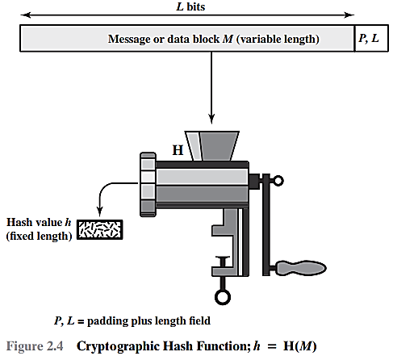

To accommodate variable size messages or data blocks

Slide 30
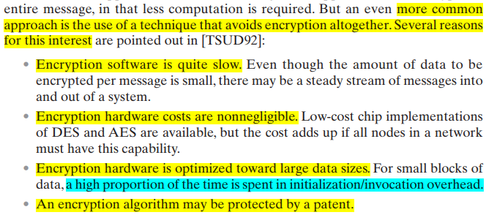

Slide 31
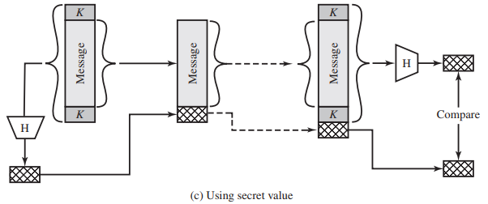
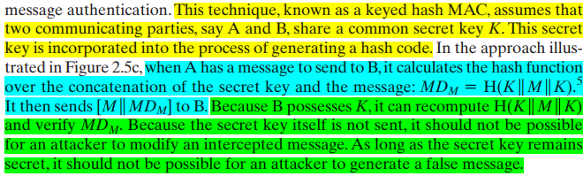

Slide 32

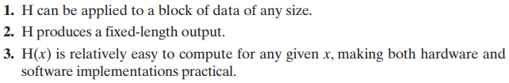
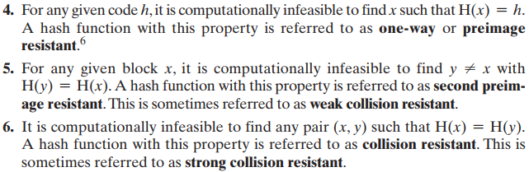
This property protects against an attacker who only has a hash value and is trying to find the input.
This property of hash function protects against an attacker who has an input value and its hash, and wants to substitute different value as legitimate value in place of original input value.
This property makes it very difficult for an attacker to find two input values with the same hash.

Slide 33
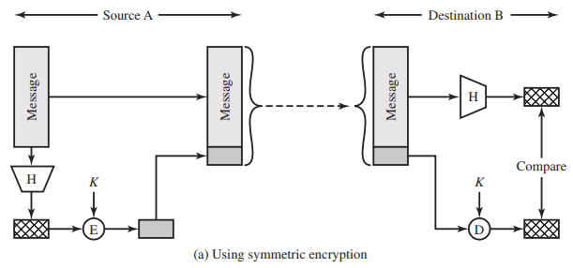
if it is assumed that only the sender and receiver share the encryption key, then authenticity is assured
Why Encryption?

Slide 34
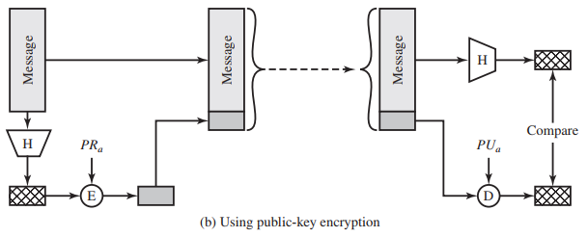
The public key approach has two advantages: It provides a digital signature as well as message authentication, and it does not require the distribution of keys to communicating parties.

Slide 35
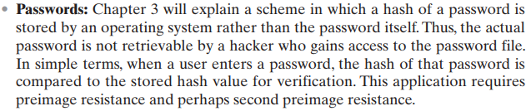


Slide 36



Slide 37


Slide 38

directed toward providing confidentiality

Slide 39

directed toward providing authentication and/or data integrity.

Slide 40


Slide 41


Slide 42


FACT 1, FACT 2 and Conjecture # 3 are not part of syllabus

Slide 43


Slide 44



Slide 45


Slide 46


Slide 47

of the public key.

Slide 48


Slide 49


Public-Key Certificates

Slide 50



